Slide 1
Detecting molecular hydrogen line in Milky Way using Ptarmigan Triffid Military Phased Bipole Array Aerial Dr Andrew Thornett M6THO www.astronomy.me.uk Talk for BAA RAG 13/11/2023

Slide 2
Today’s talk is about setting up the 1420MHz radio telescope In January I will be giving longer talk on the results and other work at Lichfield Radio Observatory (LRO)

Slide 3
Detecting molecular hydrogen line in Milky Way using Ptarmigan Triffid Military Phased Array Aerial
Milky Way hydrogen detection used to be expensive but can now be achieved with very cheap equipment from Amazon/elsewhere, using Software Defined Radio (SDRs) and hydrogen line filter/pre-amp, and satellite dish/other aerial.
The Society of Amateur Radio Astronomers (USA/”SARA”) has a project for this called “Scope in a Box”, which led me to give this a try.

Slide 4
PEOPLE I WOULD LIKE TO THANK AND WITHOUT WHO I WOULD NOT BE GIVING THIS TALK TODAY
Andrew Thomas from BAA for giving me the Ptarmigan Triffid Array
From SARA:
Lester Veenstra for his fantastic Scope in a Box concept and for sharing both hardware requirements and software with me and giving me great support.
Ted Cline for the truly incredible mentoring he has given me and for his amazing ezRA software suite.
From BAA/UKRAA:
Andrew Thomas, Andrew Lutley, Paul Hearn – who have also helped me get my VLF receiver, magnetometer and meteor scatter experiments working

Slide 5
IN THE INTERESTS OF FULL DISCLOSURE…
I was asked to give this talk to encourage others.
I would definitely like to do that! I have a radio licence (M6THO) but this is only foundation licence and I know very little about electronics or science or engineering of radio.
HOWEVER:
Although I got the following working in 2-3 months….
It has taken hundreds of hours – I have been off work and this has given me the time.
And taken a LOT of support to get there!
BUT IT IS VERY EXCITING!!! AND WORKS WHEN IT IS CLOUDY OR RAINING!!!!!

Slide 6
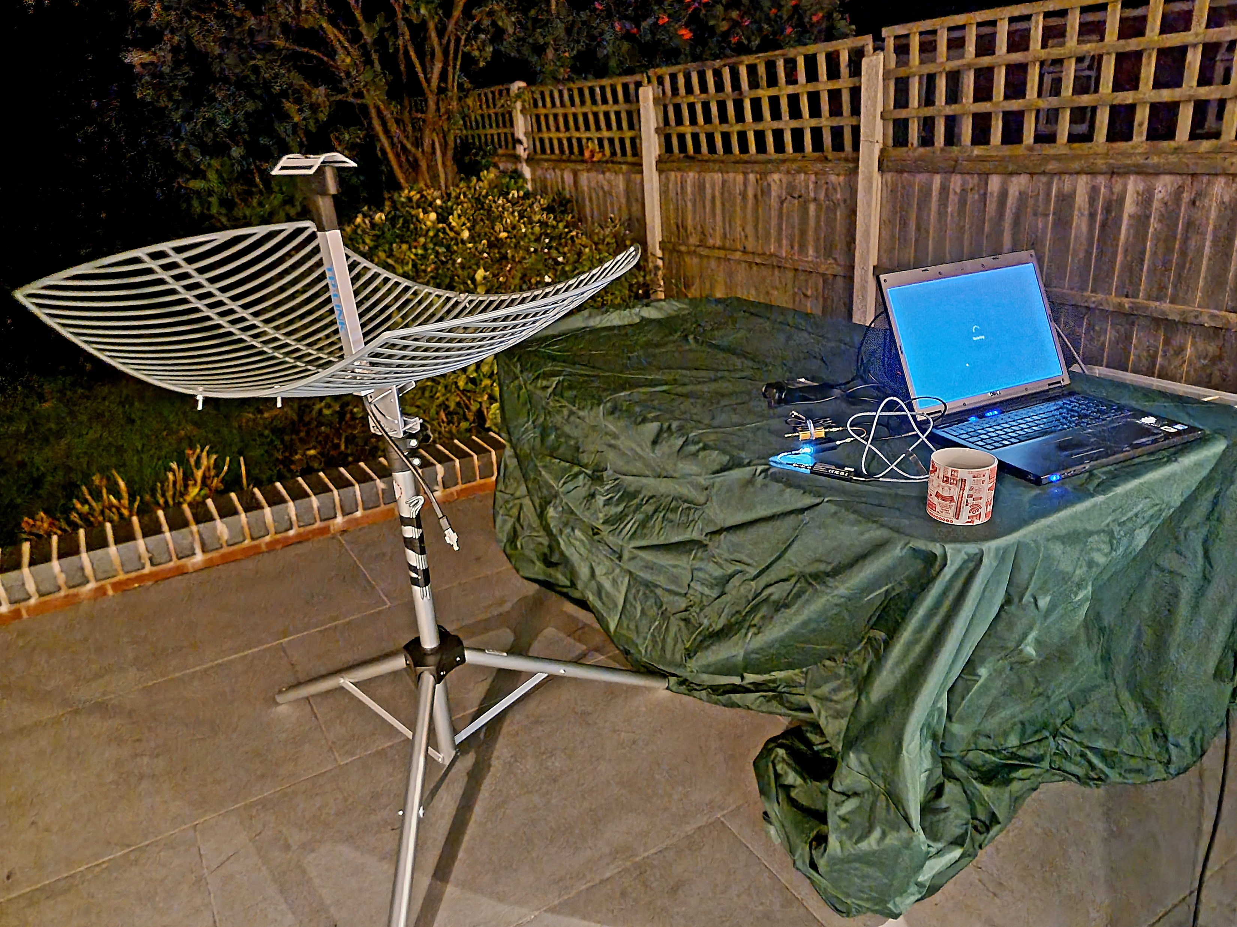
SARA Scope in a Box
This aerial is not ideal as tuned to 1.7GHz rather than 1.4GHZ

Slide 7
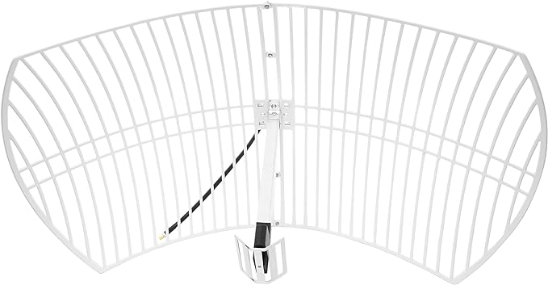
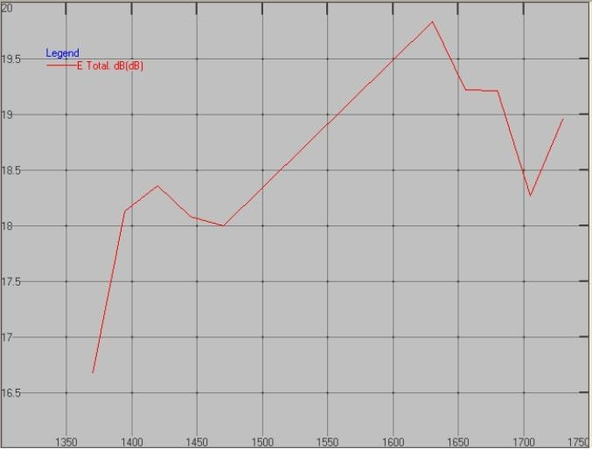
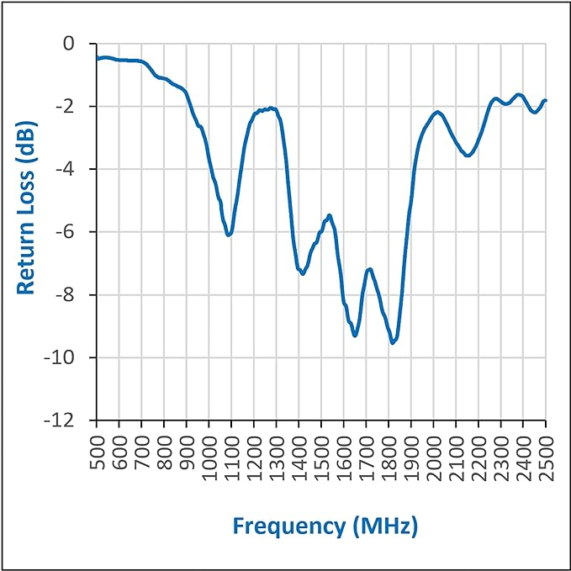
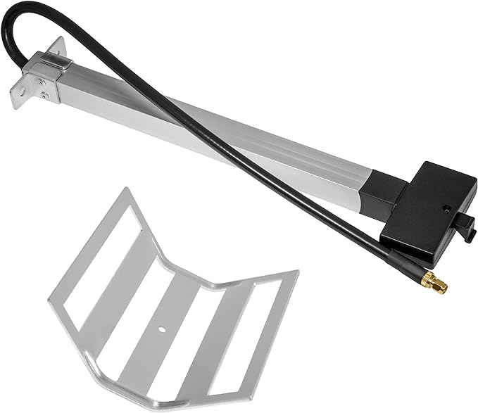
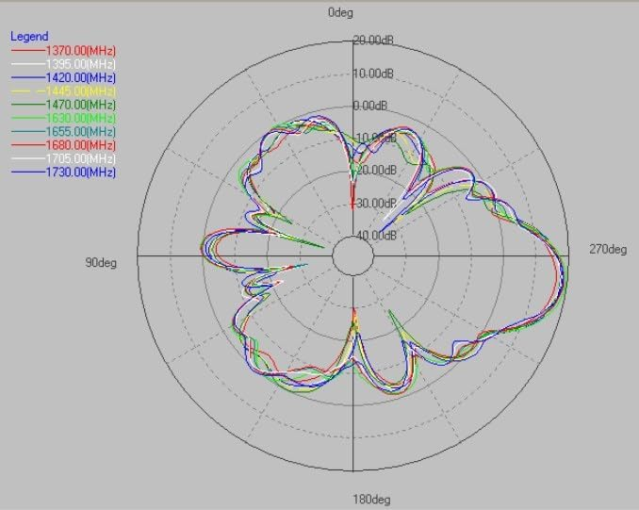
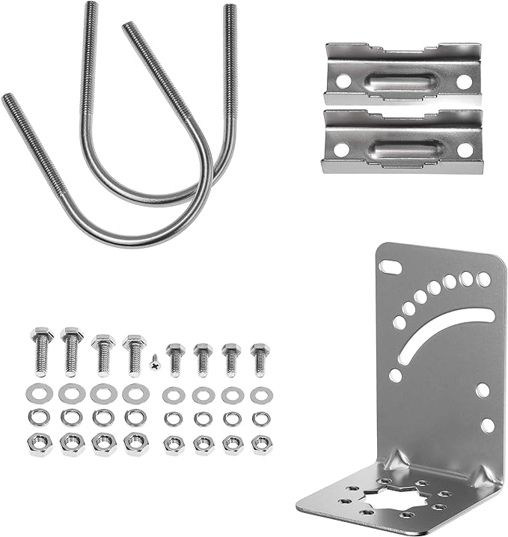
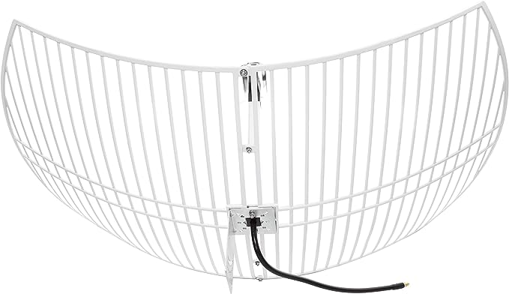
New 1.4GHz tuned aerial from Nooelec

Slide 8
MORE ABOUT THIS LATER
New 1.4GHz tuned aerial from Nooelec

Slide 9
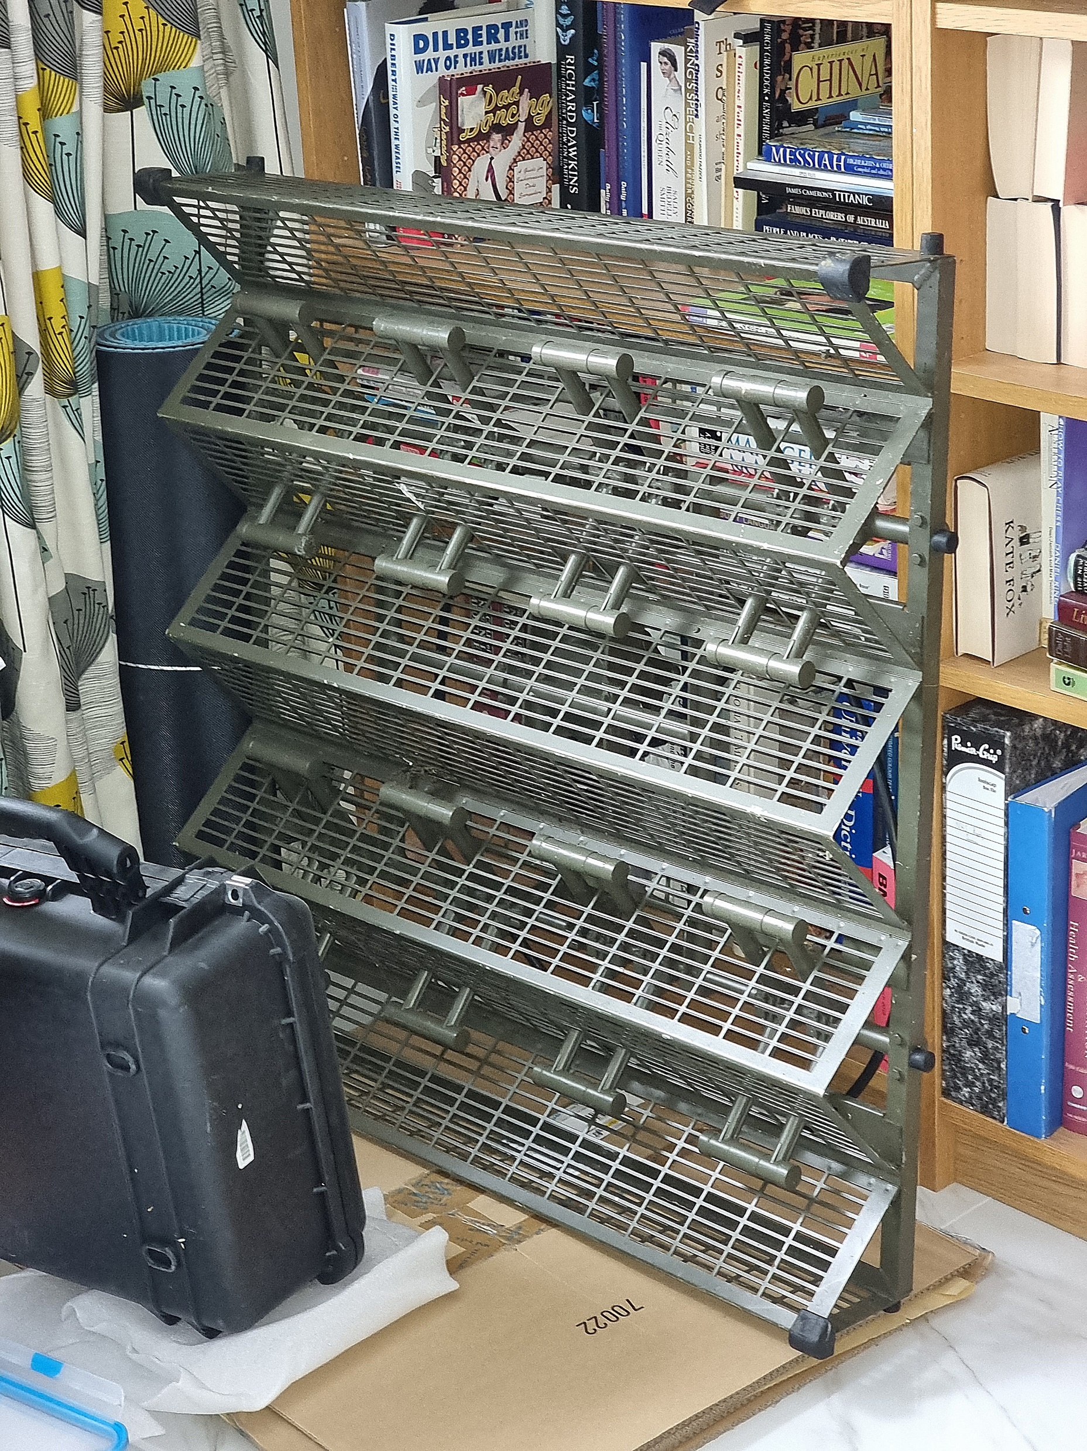
I have been very lucky
& have been given one of these…
Ptarmigan Triffid Military Phased Array

Slide 10
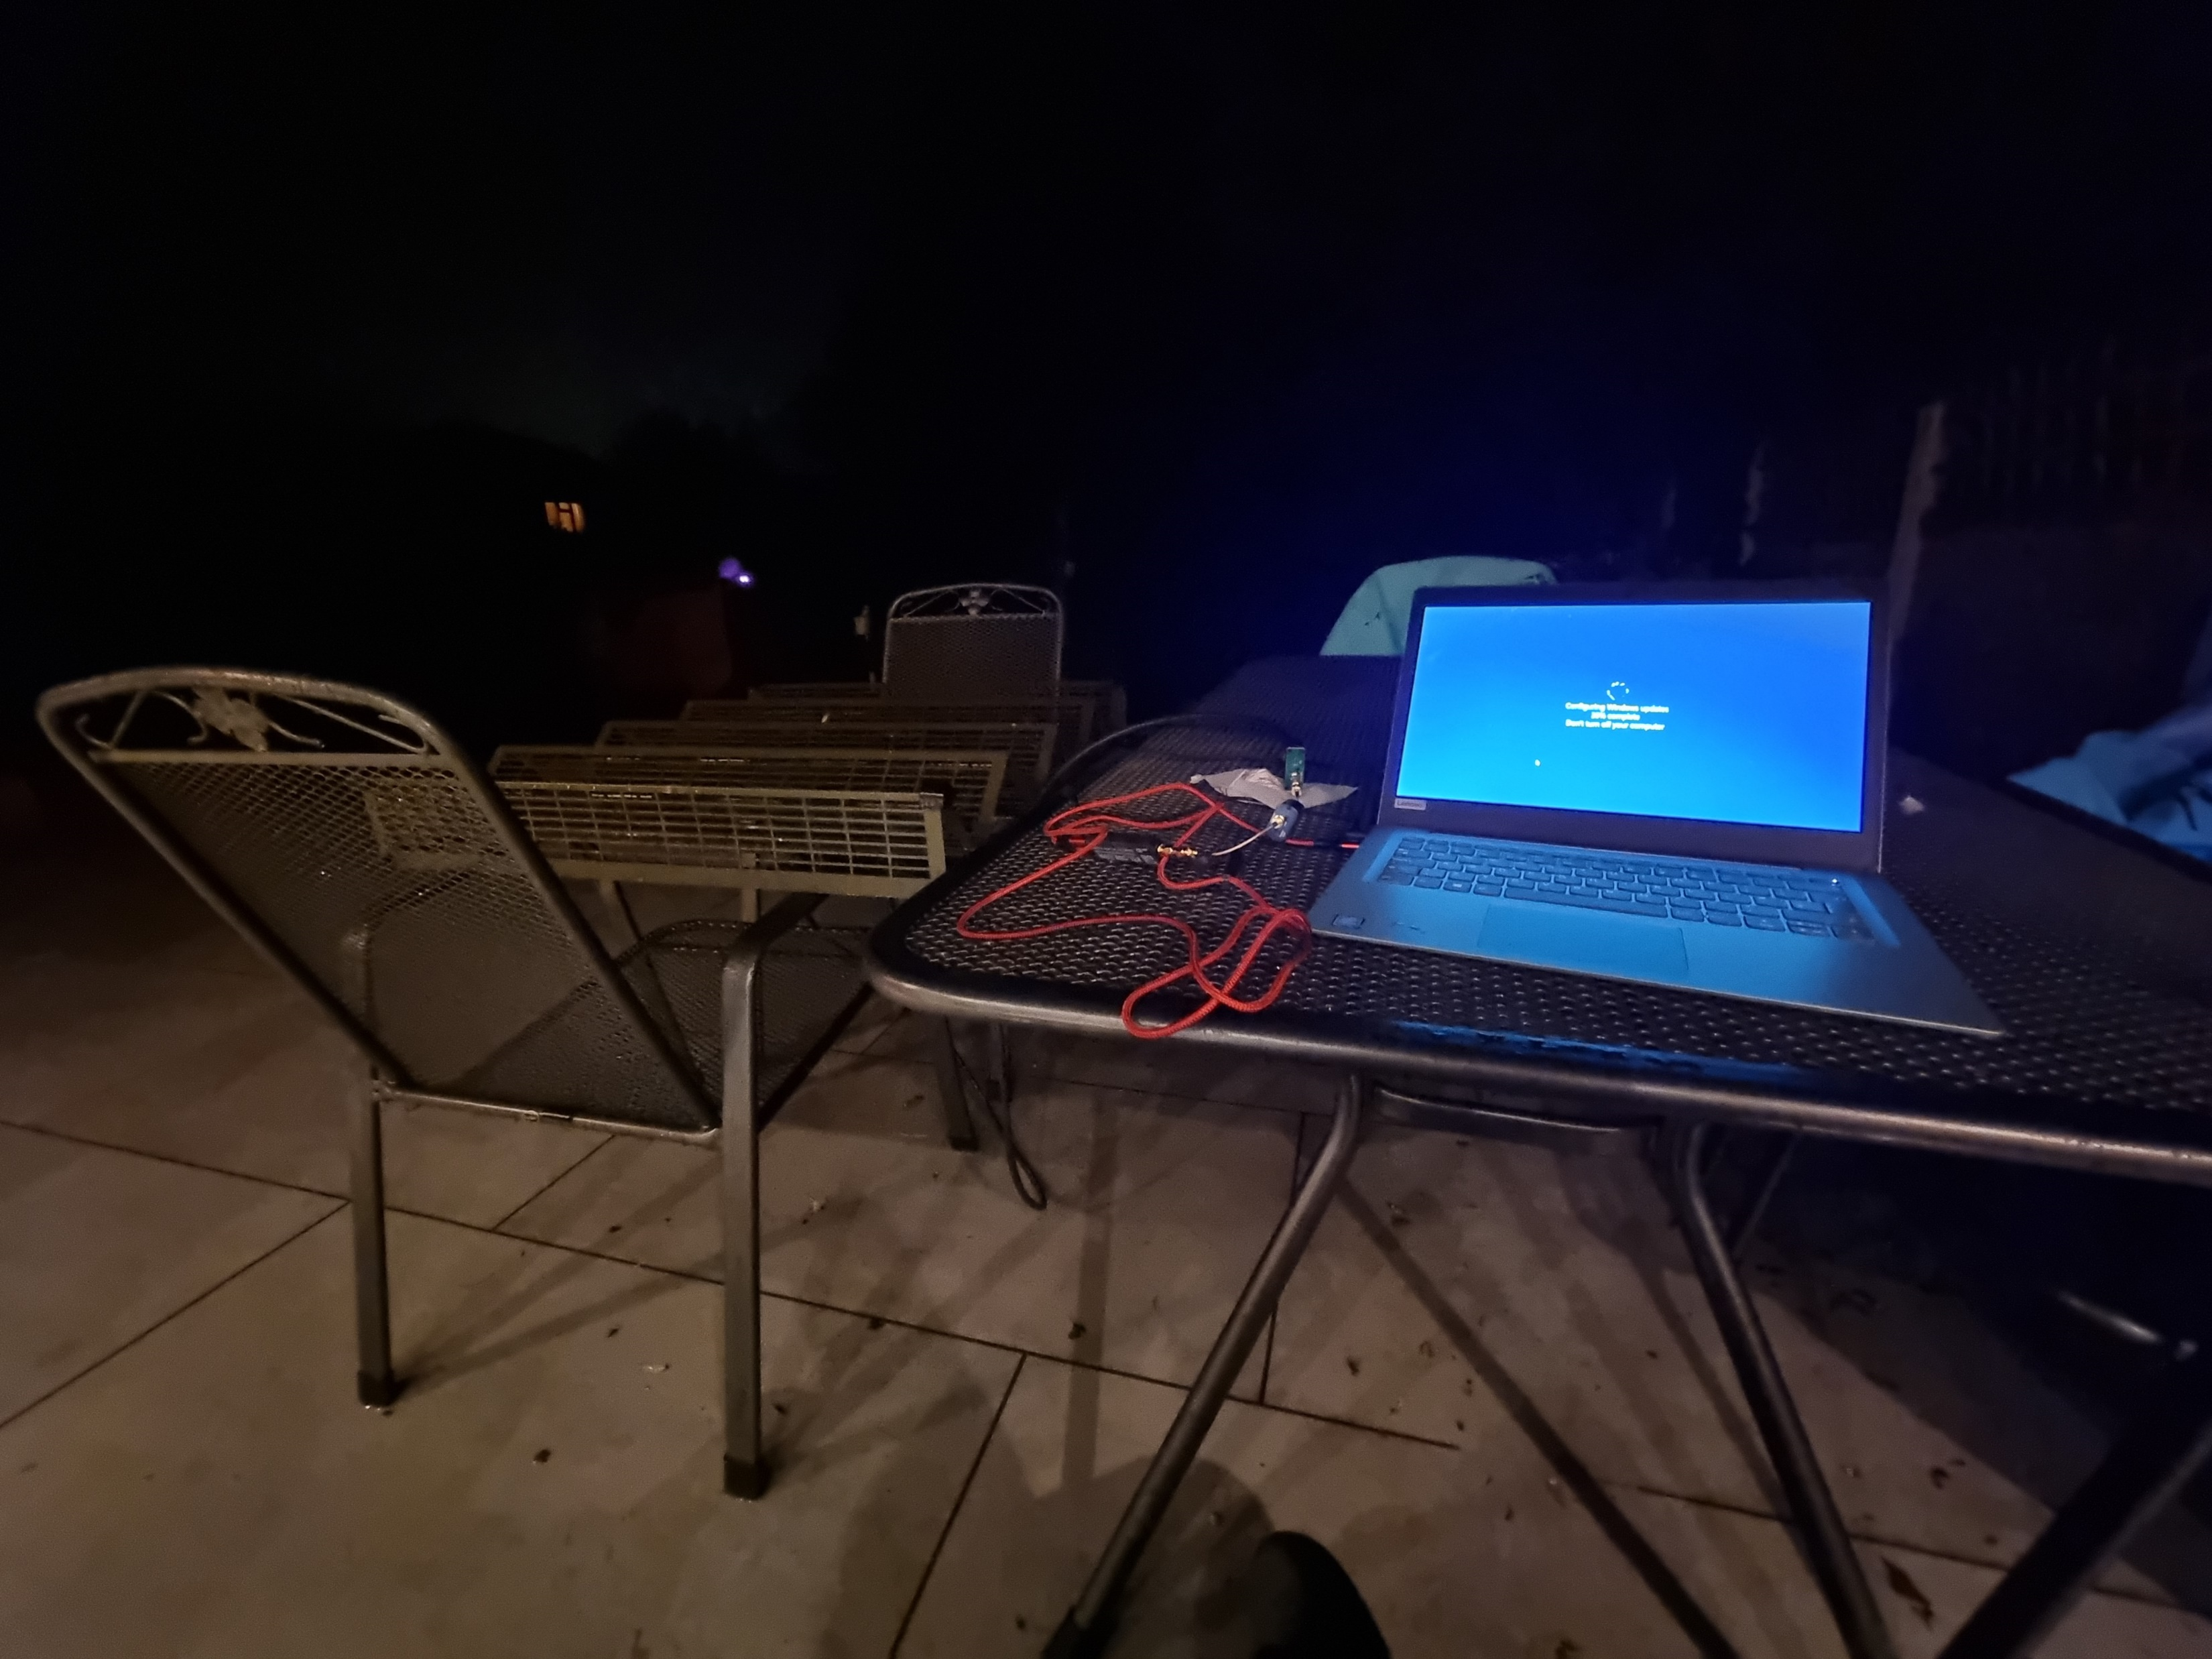
Out on the patio with the Scope in a Box with phased array

Slide 11
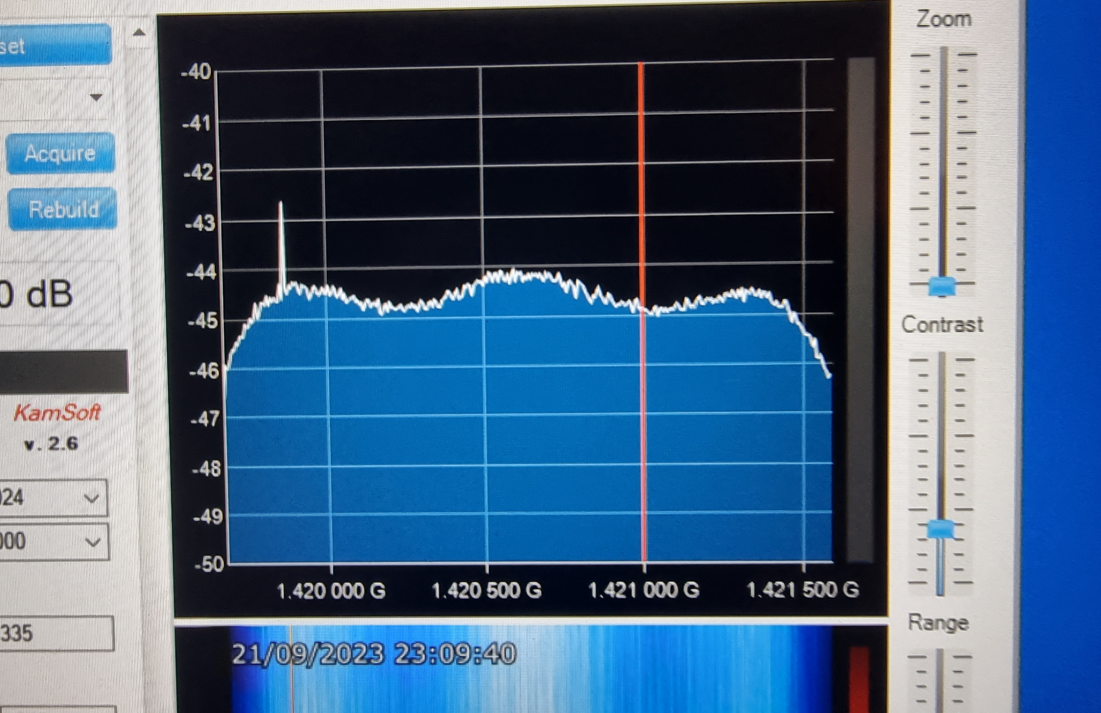
Raw Data on SDR#

Slide 12
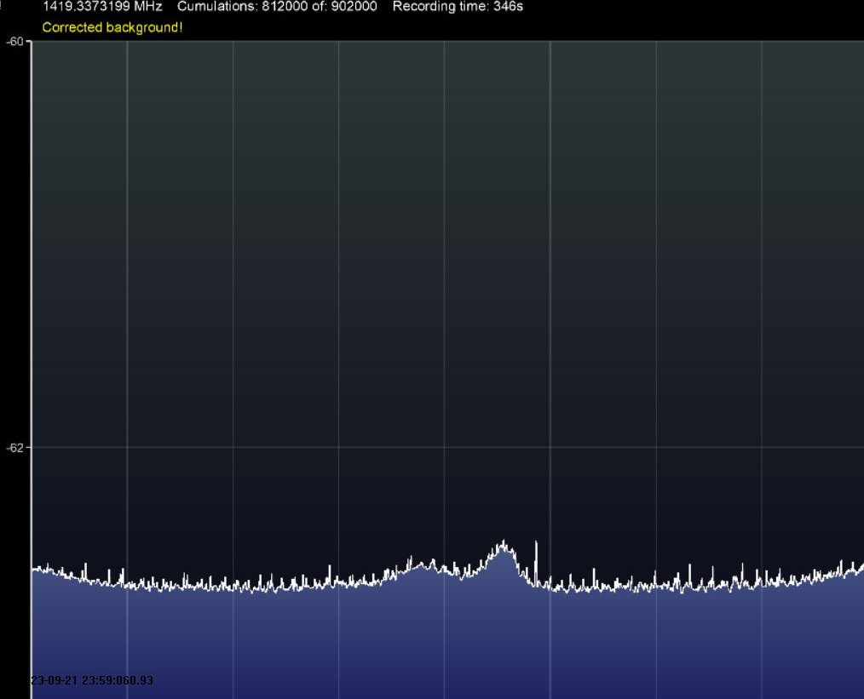
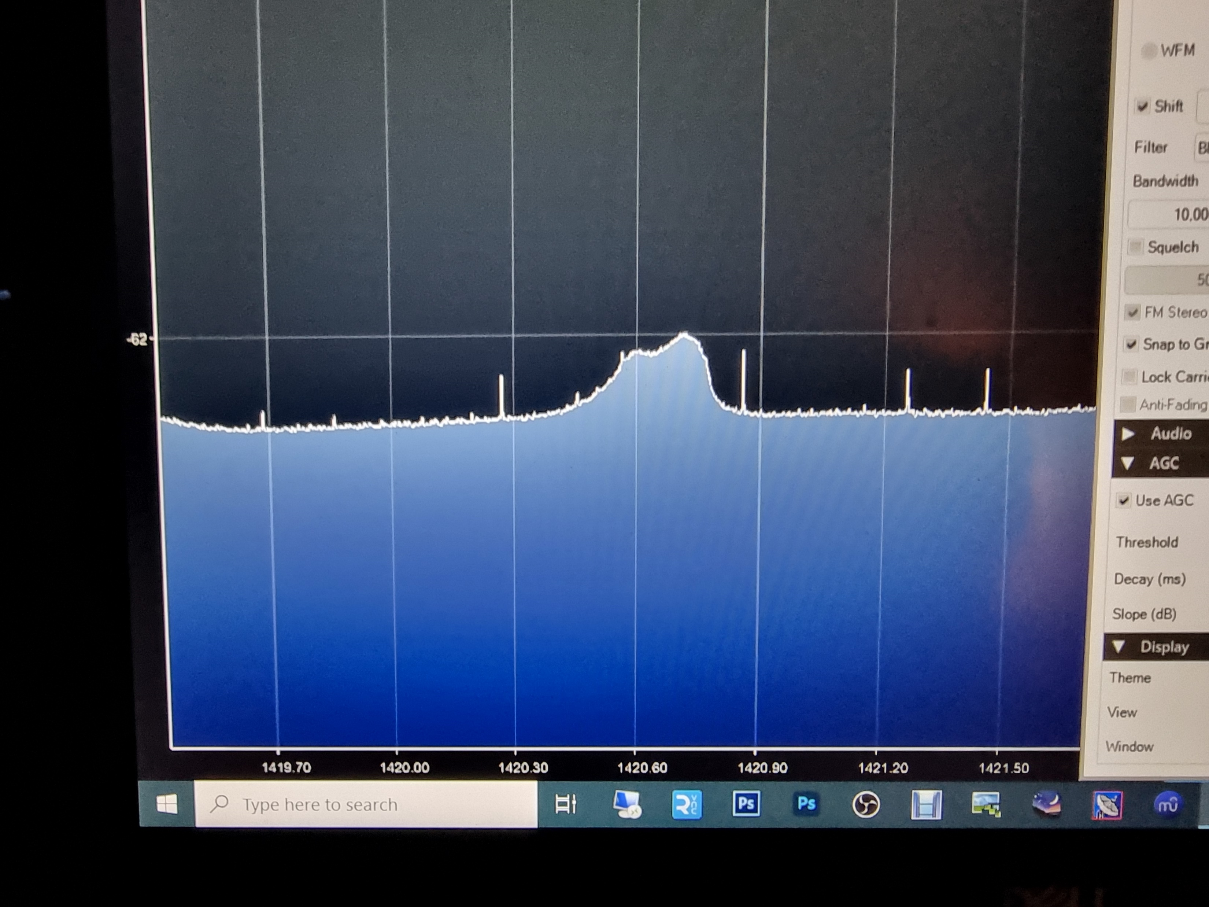
Success! Detected galactic hydrogen
Cygnus Cassiopeia

Slide 13
Note this shows hydrogen at expected 1420MHz frequency

Slide 14
Calibration of Scope in a Box in SDR# Software with IF Average plug in
This does similar job to flats and darks in astrophotography

Slide 15
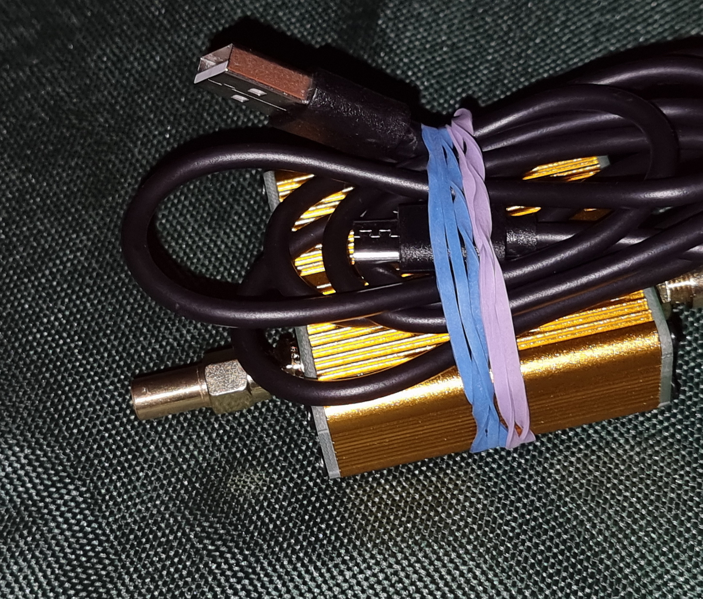
50 ohm load used in place of aerial

Slide 16
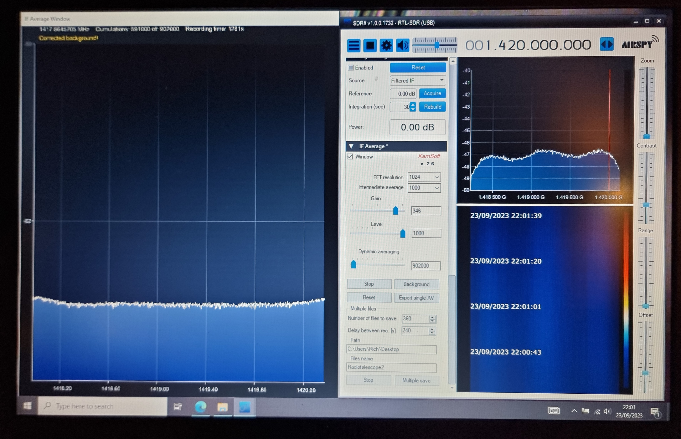
Correct image (left) vs uncorrected image (right)

Slide 17
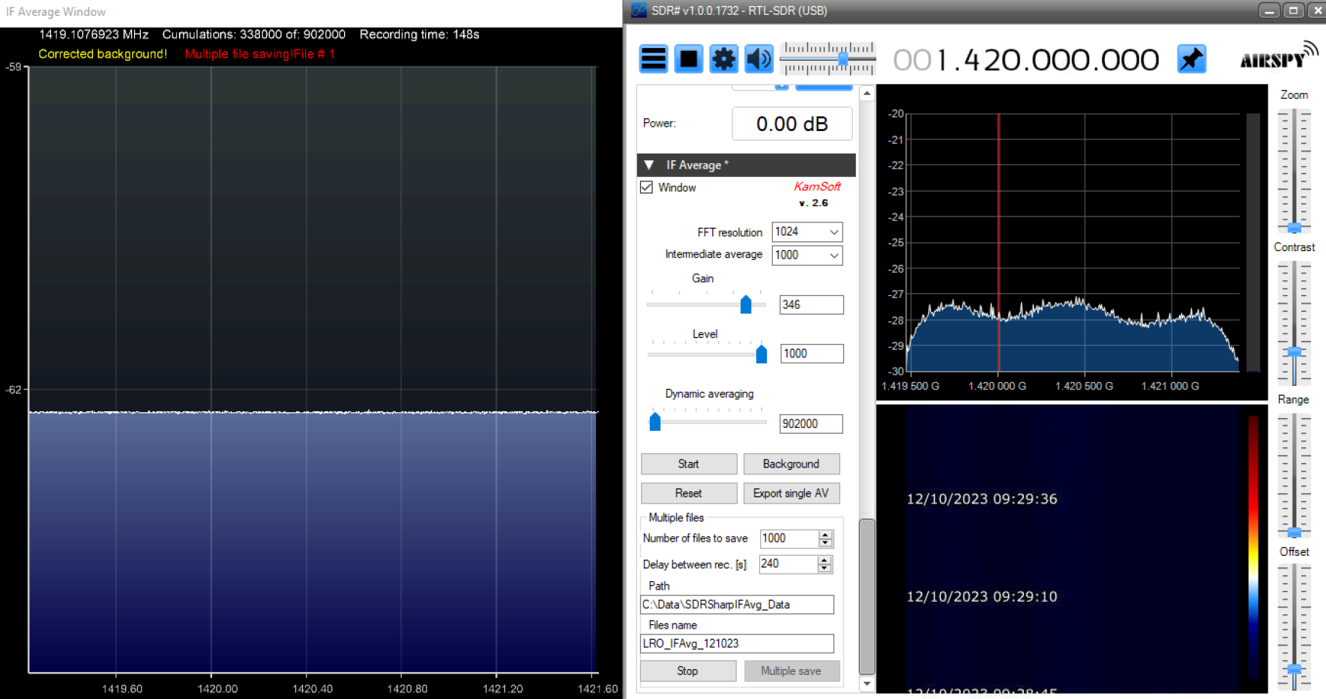
Note on calibration = I seem to get better calibration by pointing away from Milky Way than 50 Ohm dummy load

Slide 18
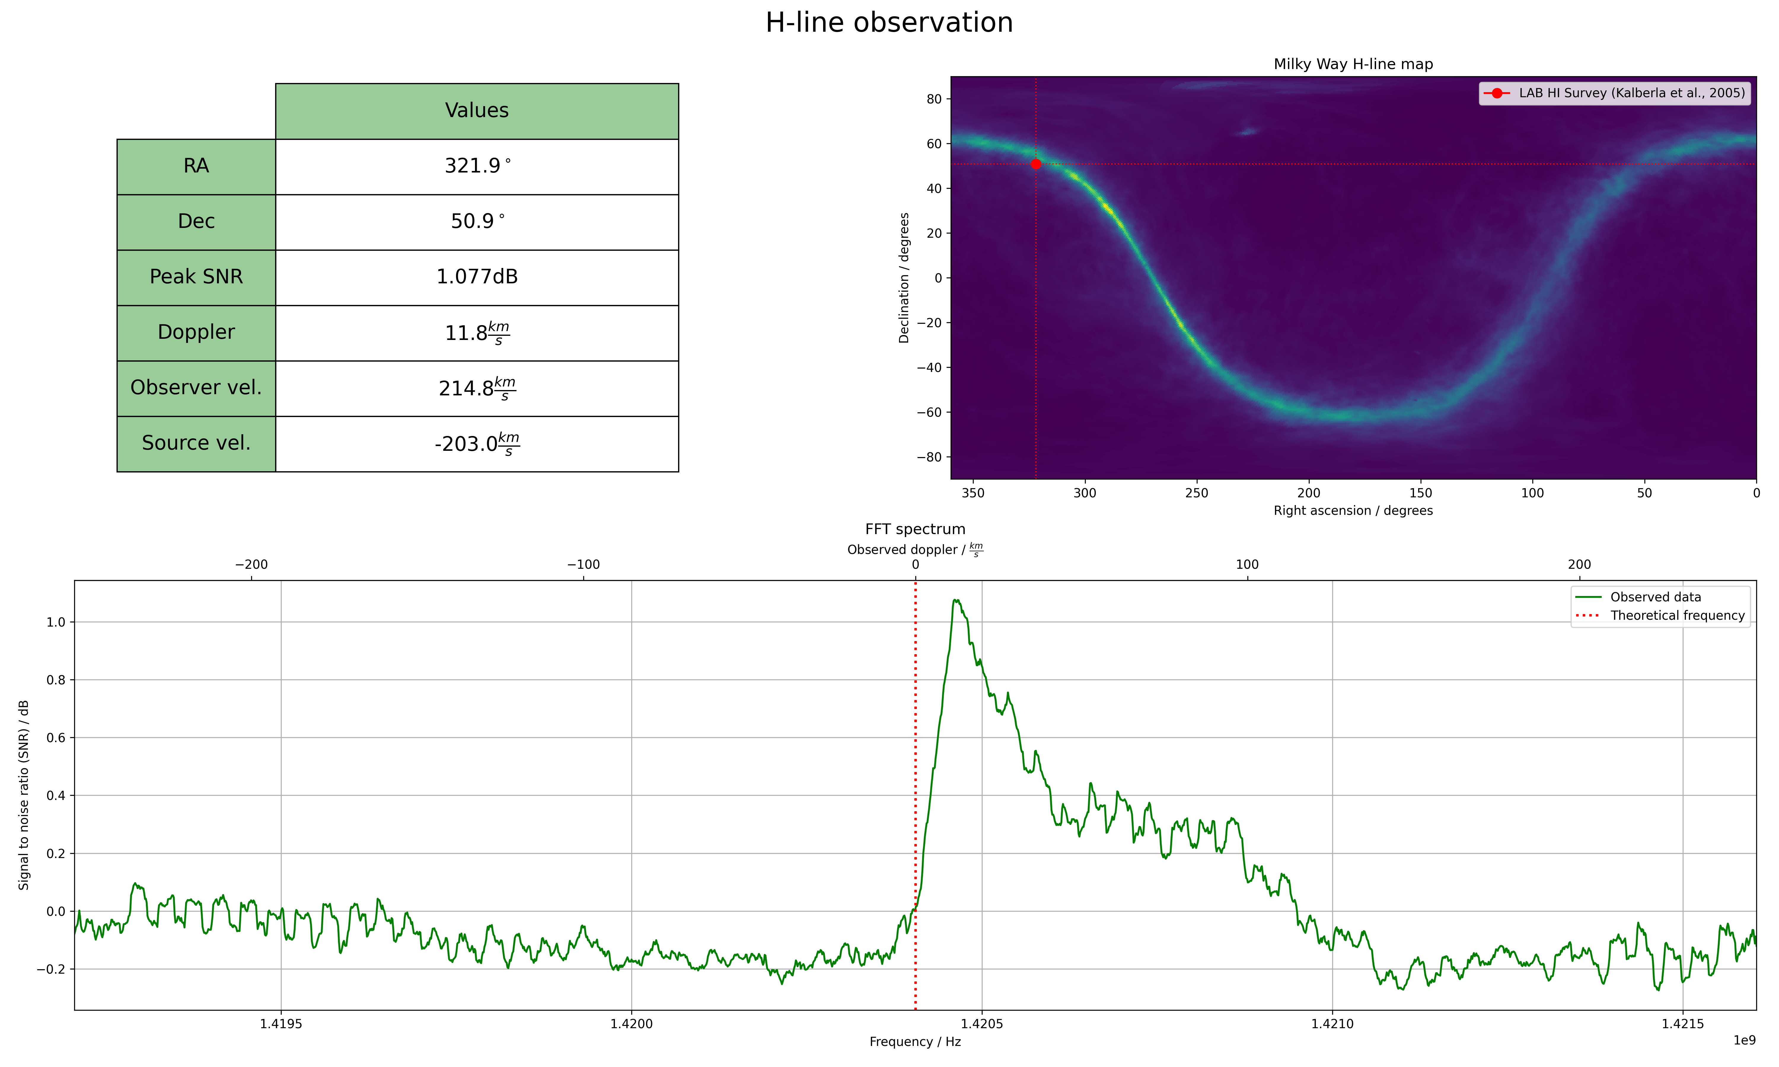
From SteveBz from Stargazers Lounge
Shows profound effect of turning off electronics on noise on plot

Slide 19
ezRA software for collecting and processing data and mapping it over known background of radio sources in Milky Way
(Has own collection program, alternative= SDR# IFAverage Plug-In to collect data)

Slide 20
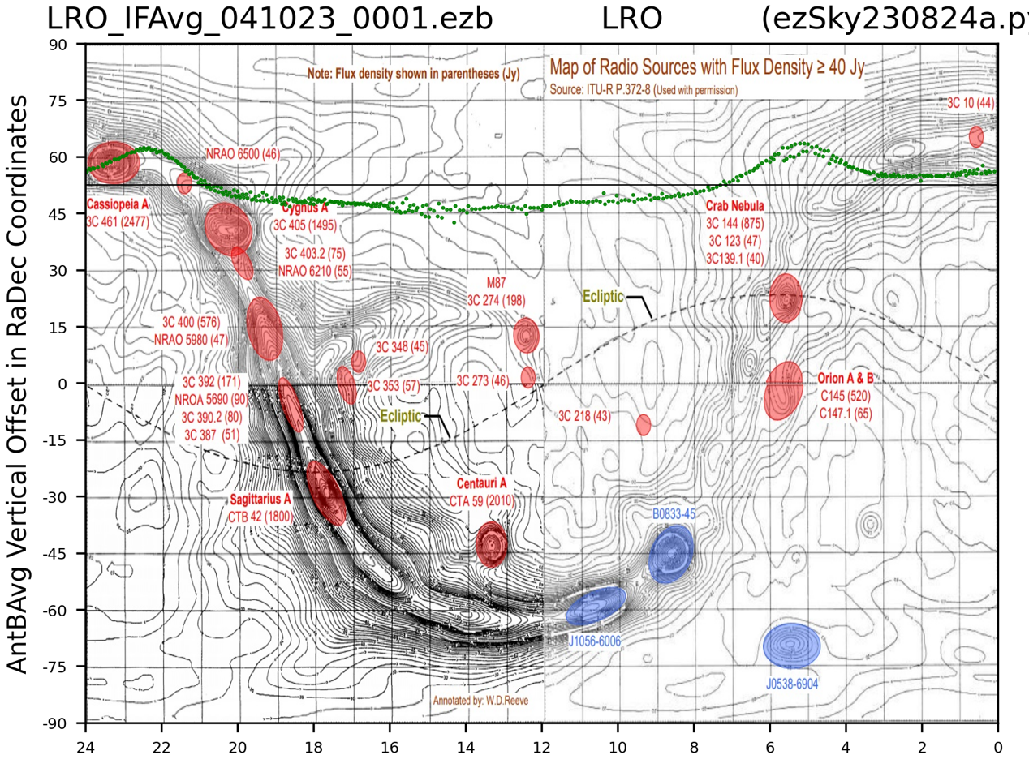
4 day drift scan of Zenith Oct 2023 from Lichfield, UK

Slide 21
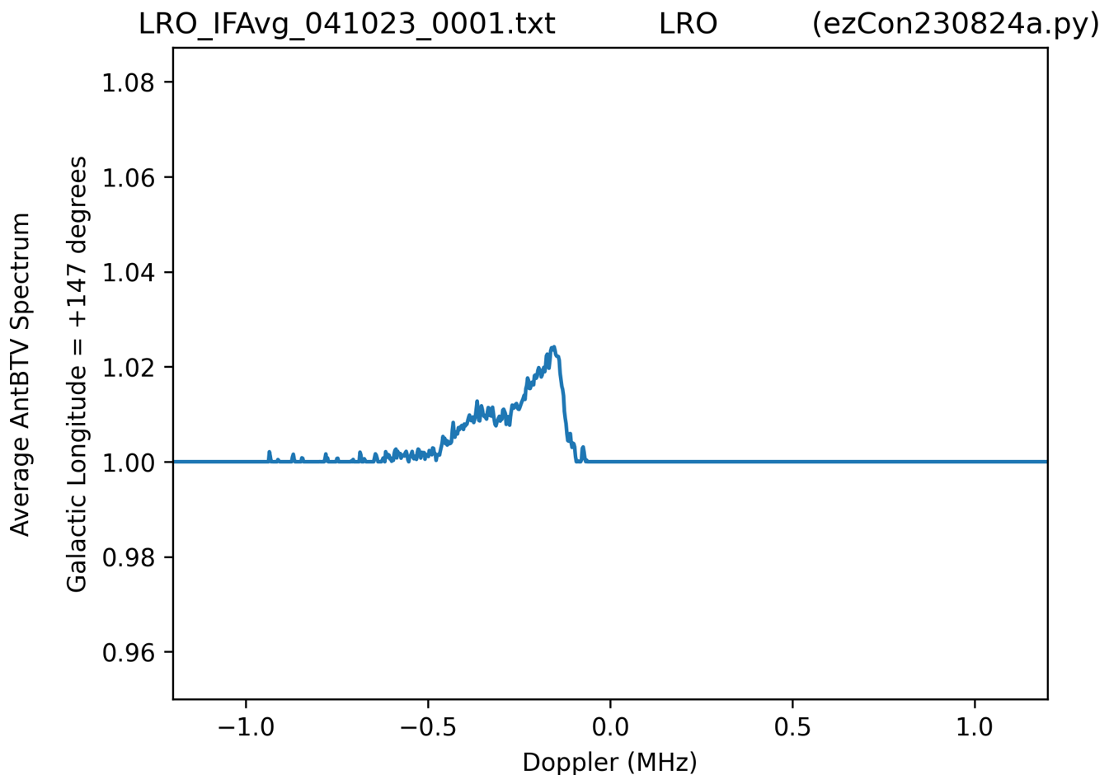
Radio Spectra
By longitude

Slide 22
Doppler Shift

Slide 23
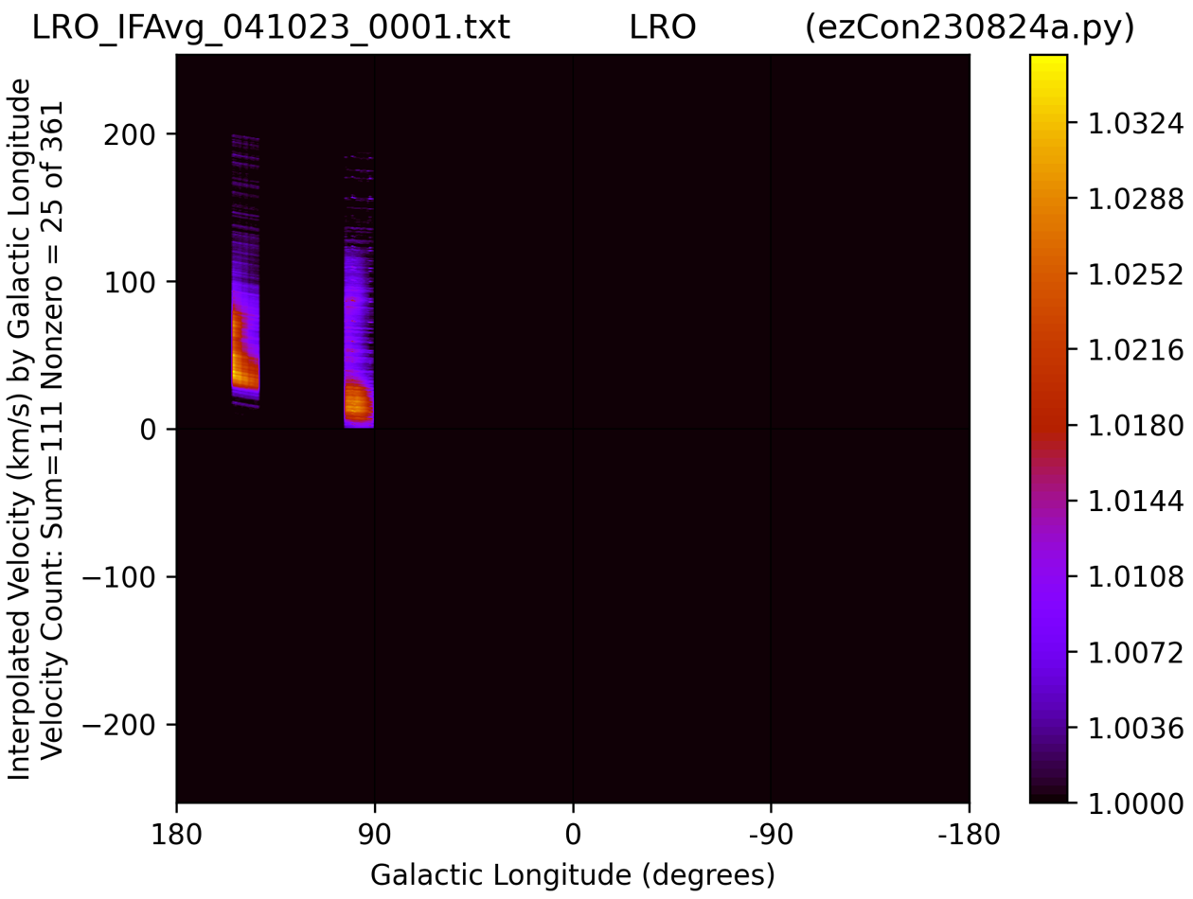
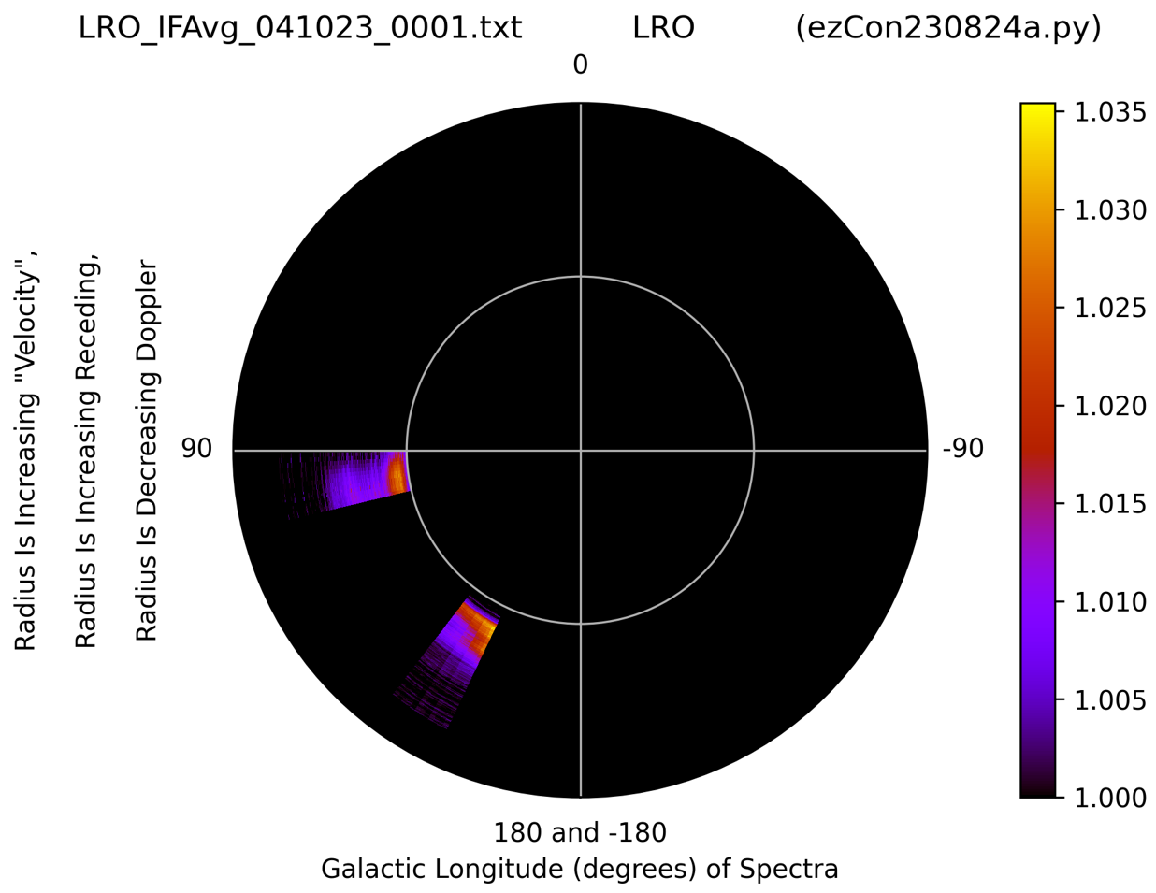
Velocity Plots

Slide 24
My results (left) = good match for simulated results (right)

Slide 25
Beamwidth of array
Half power on my initial data is -3 dB.
Ted Cline SARA calculates ca. 15 degree Half Power Beamwidth (HPBW).
Parabolic Dish Half Power Beamwidth
HPBW = 70 * wavelength / diameter
which is the same as
diameter = 70 * wavelength / HPBW
= 70 degrees * 0.21 meters / 17 degrees
= 0.86 meters
So, if we believe my antenna radiation pattern image,
Then array approx. = 0.86 meter diameter dish
(i.e. My initial ezRA (ezCon) plots match physical size array=86 x 86cm)

Slide 26
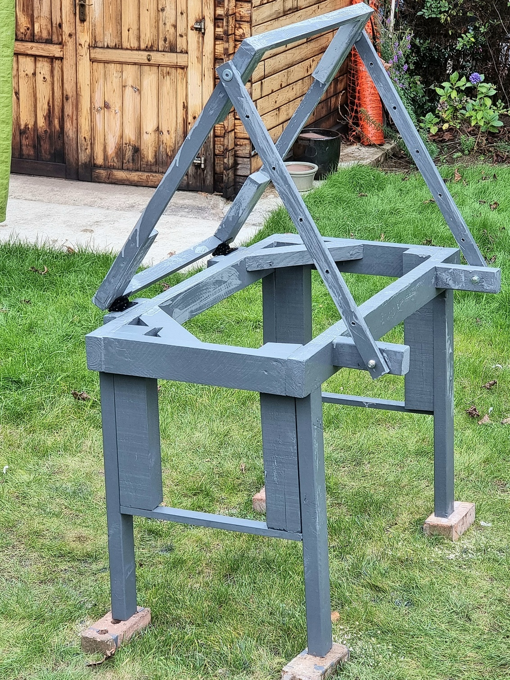
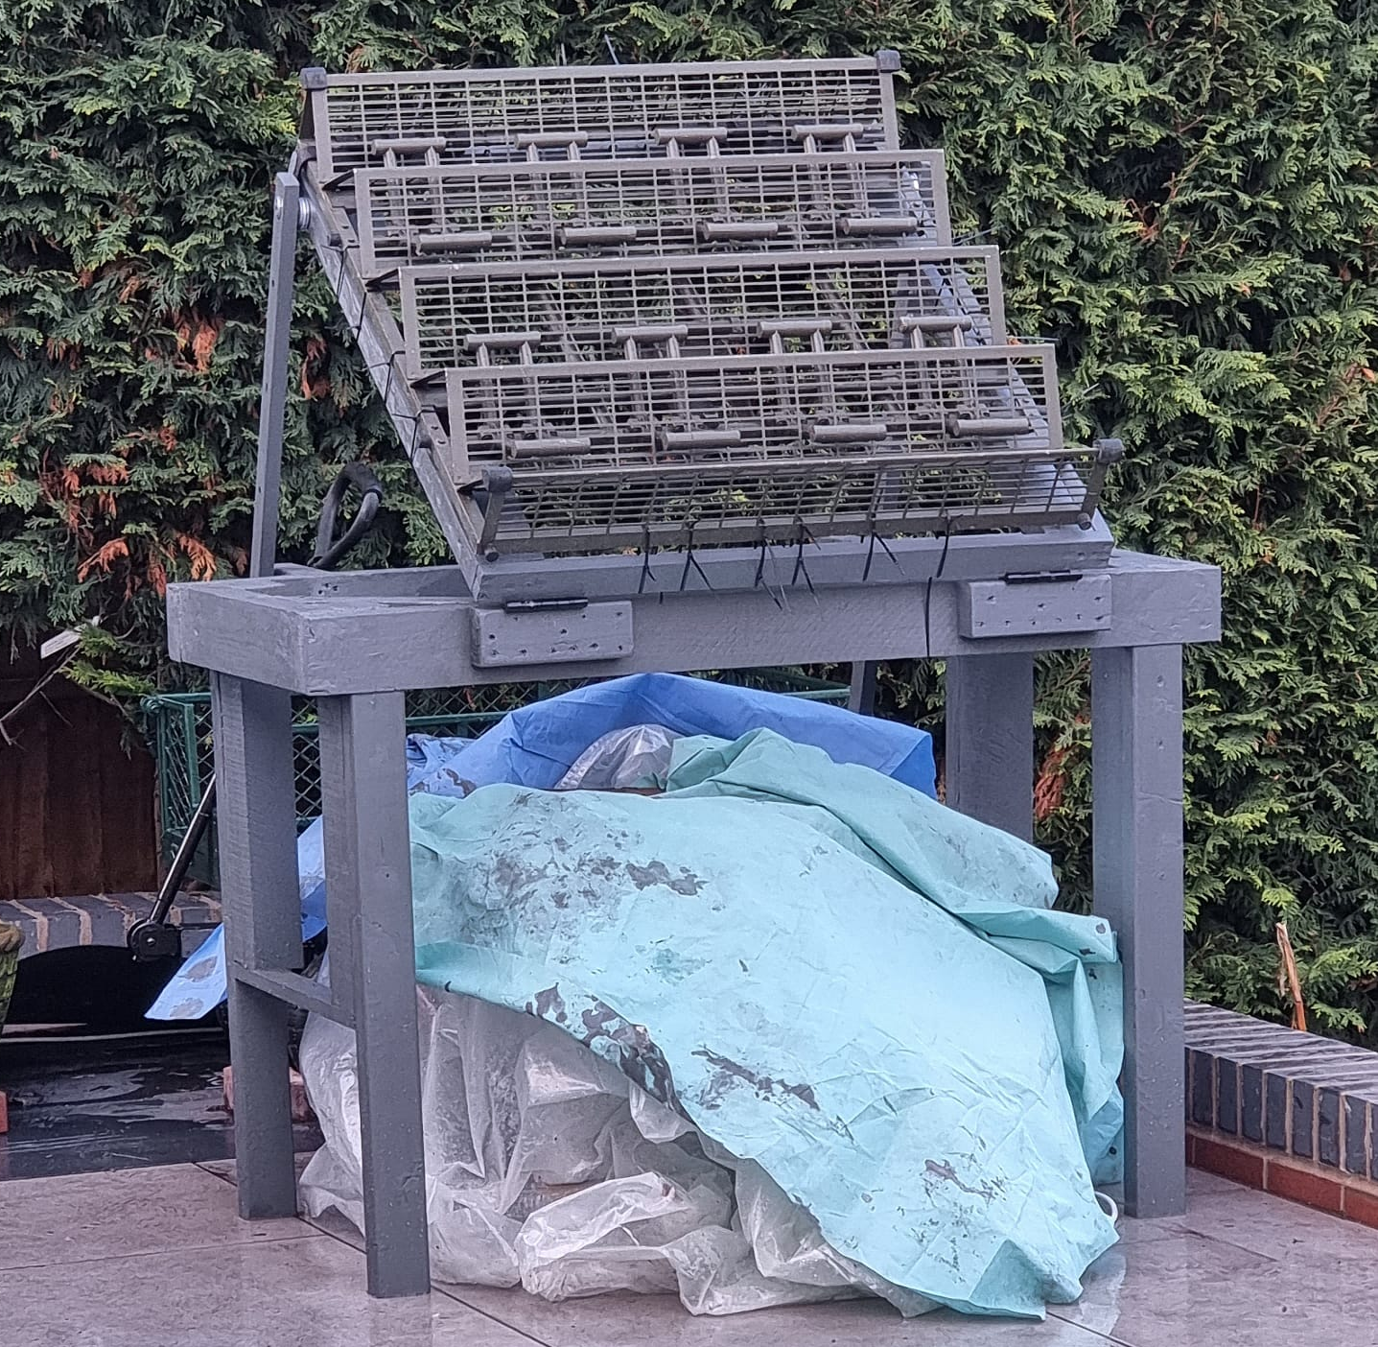
Mounting telescope so that altitude can be varied

Slide 27
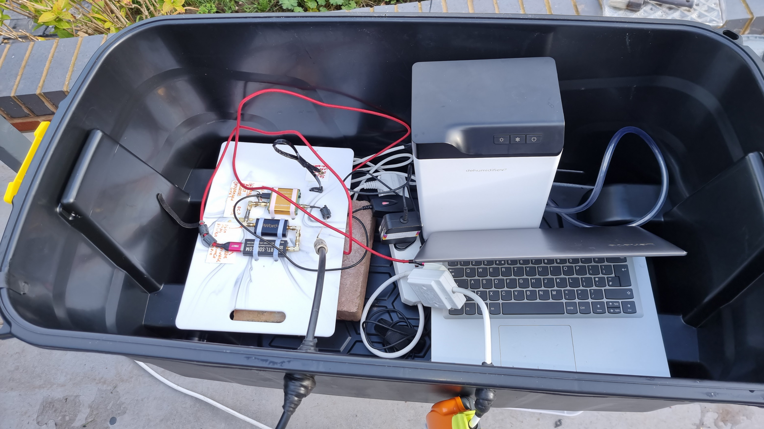
Dealing with dew – a MAJOR problem!!

Slide 28
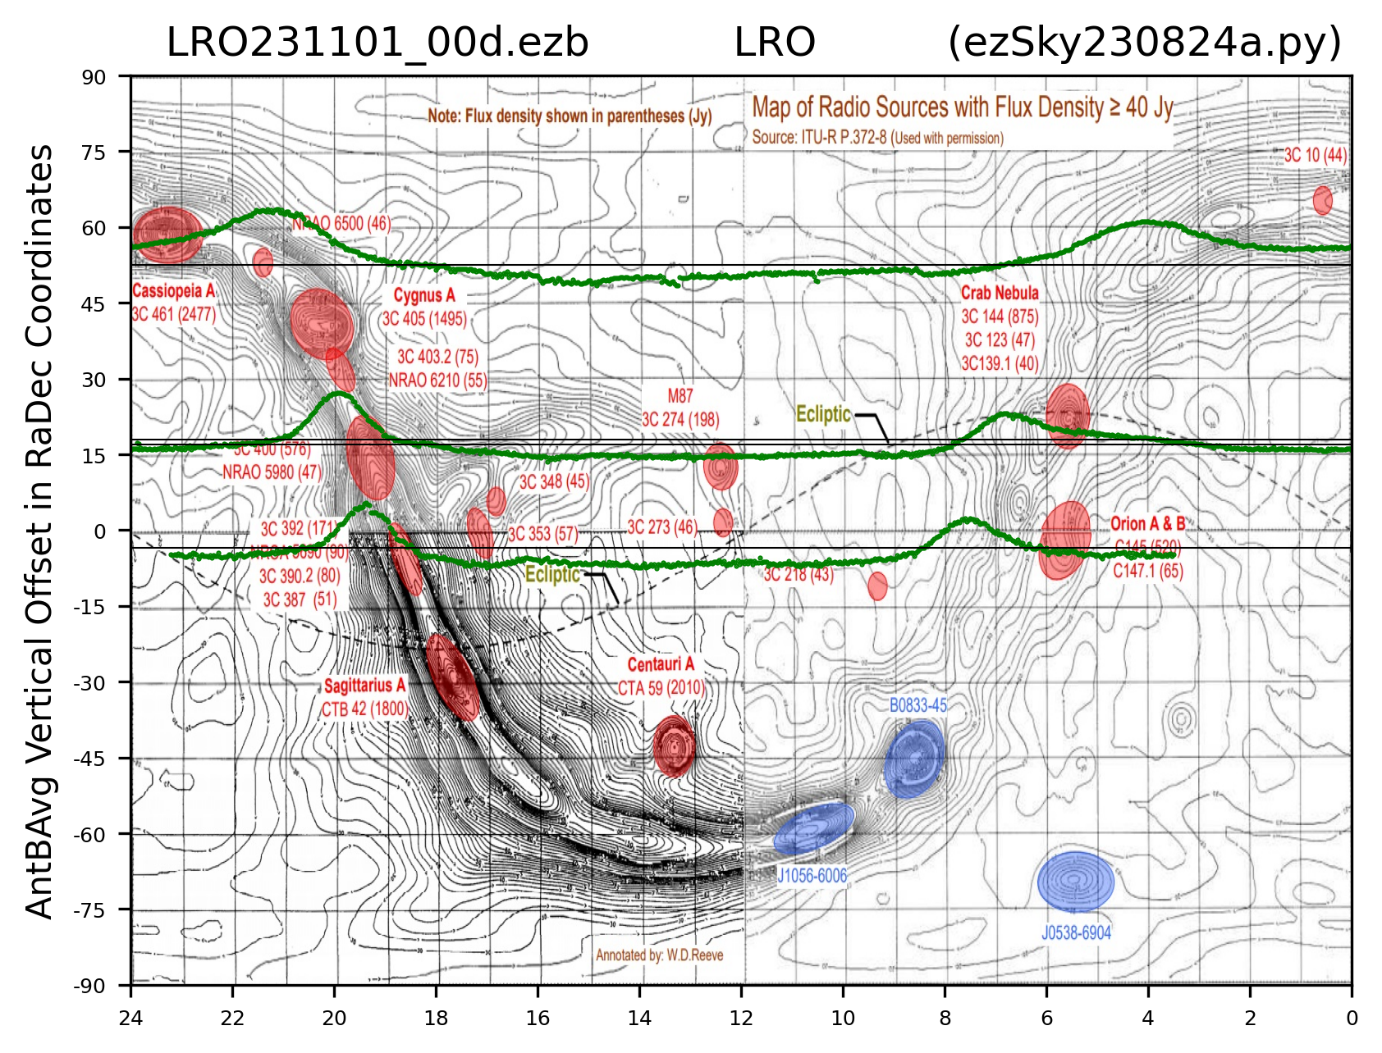
Initial Results

Slide 29
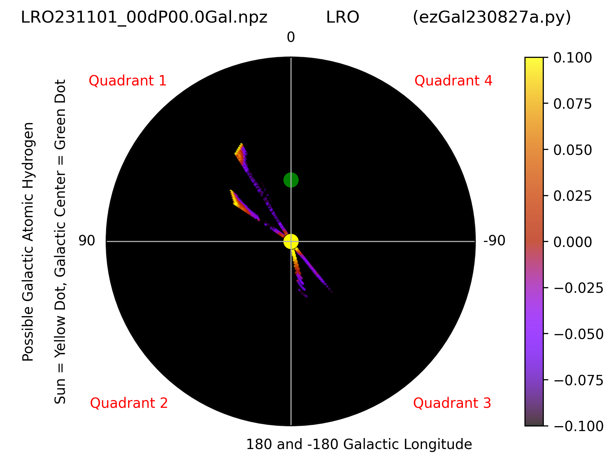

Slide 30
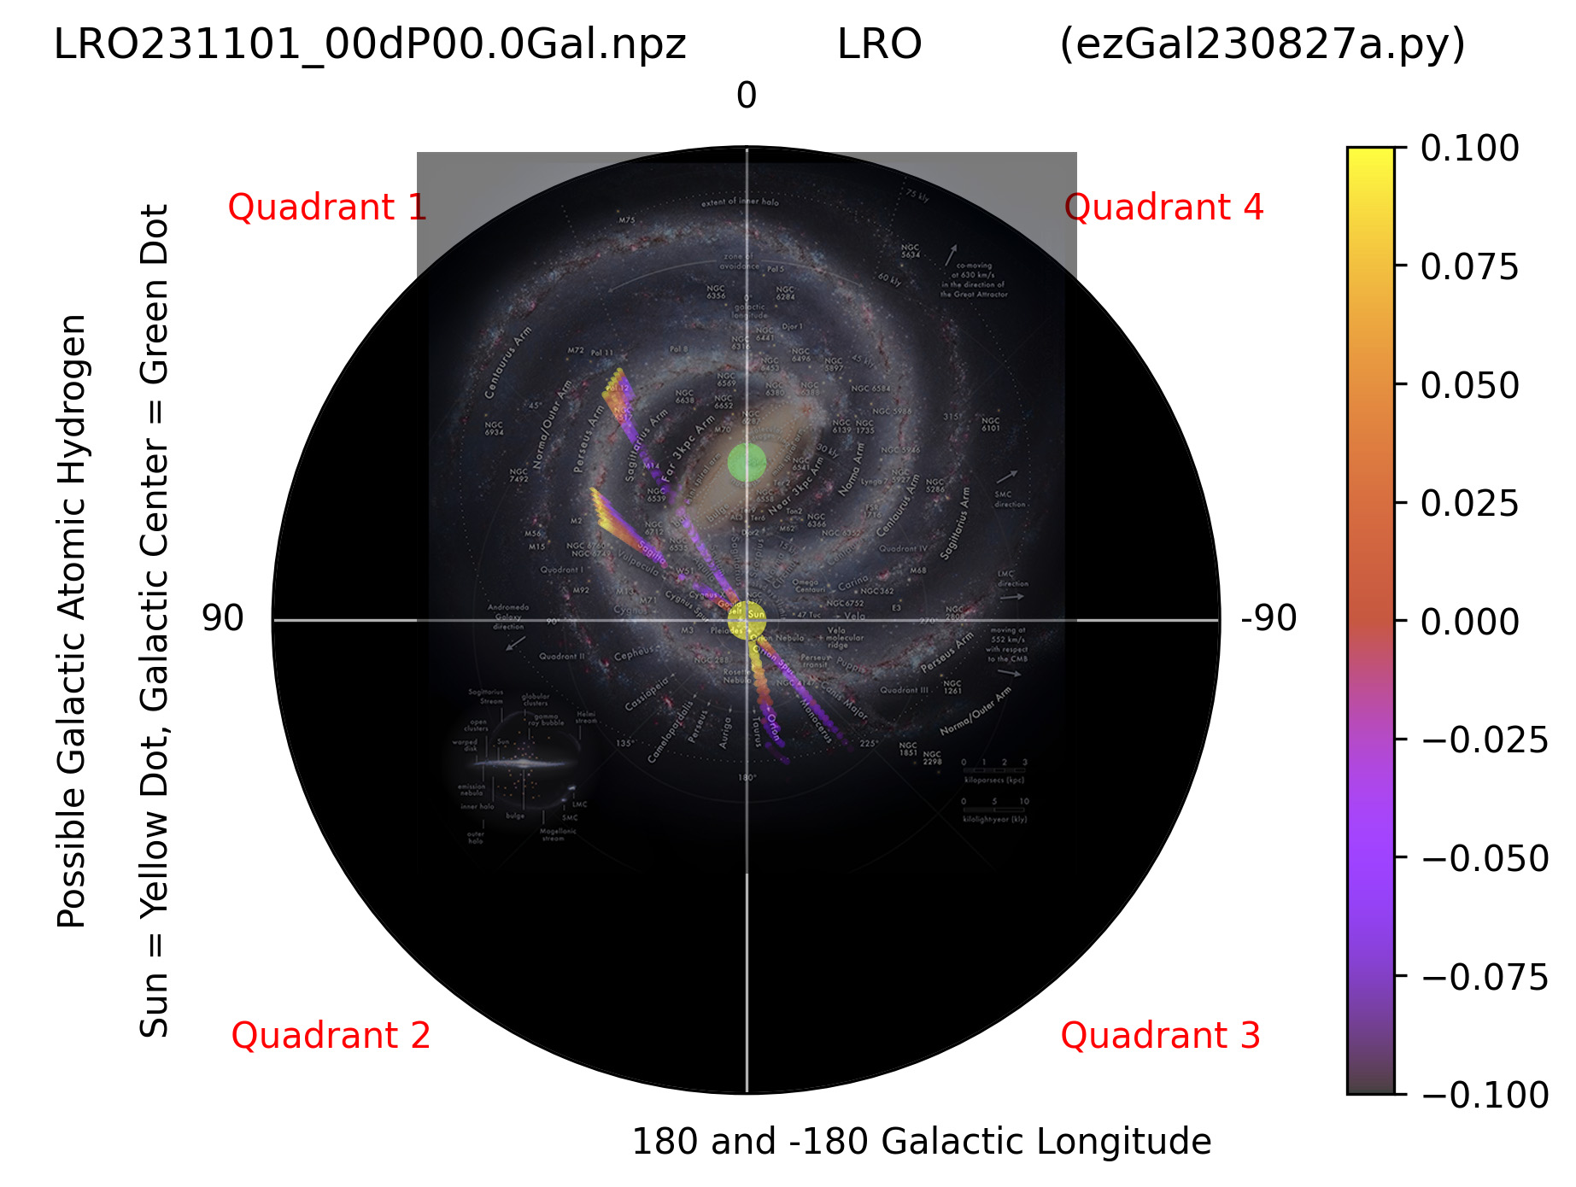

Slide 31
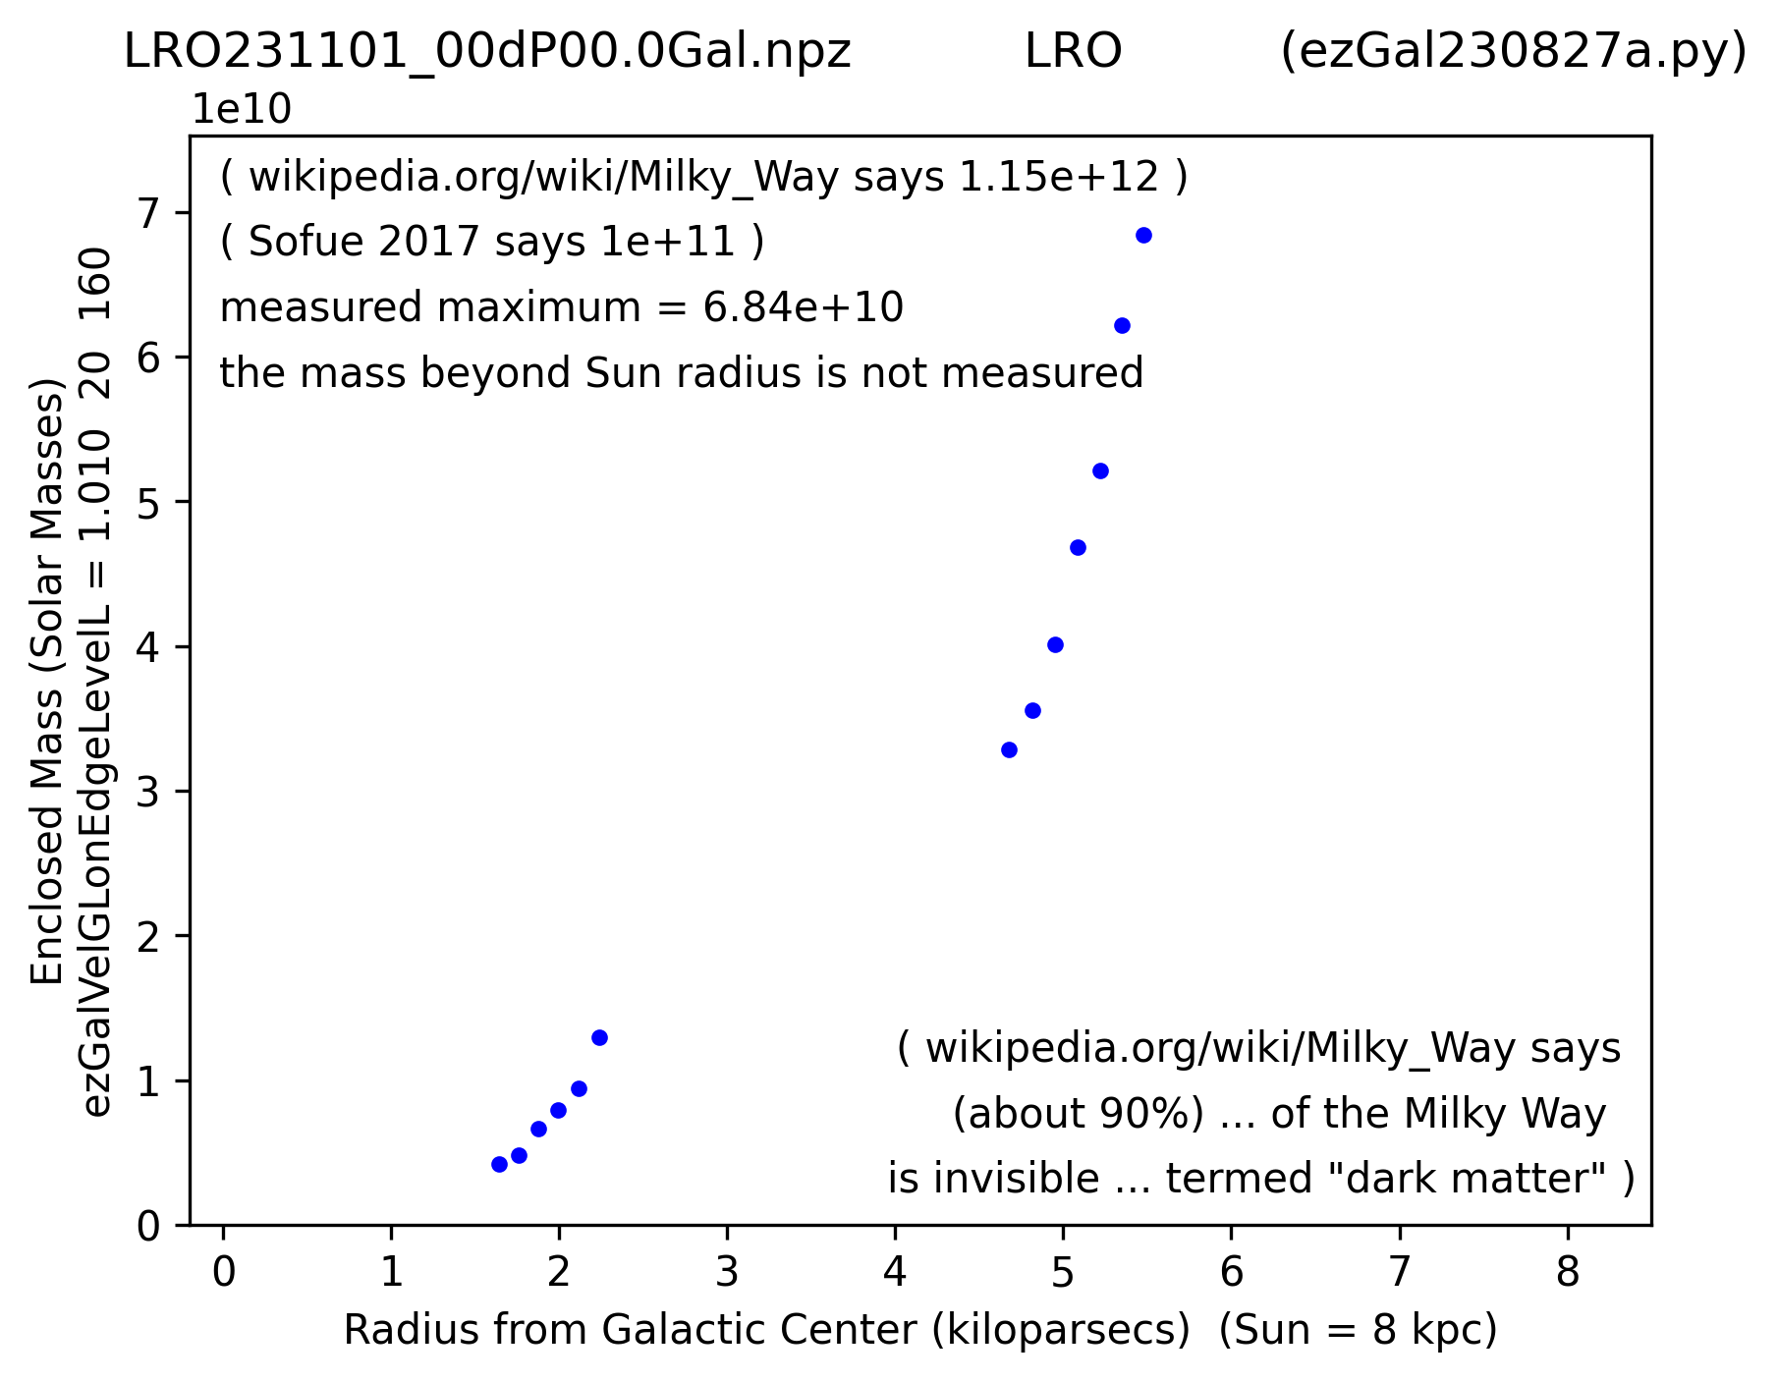

Slide 32
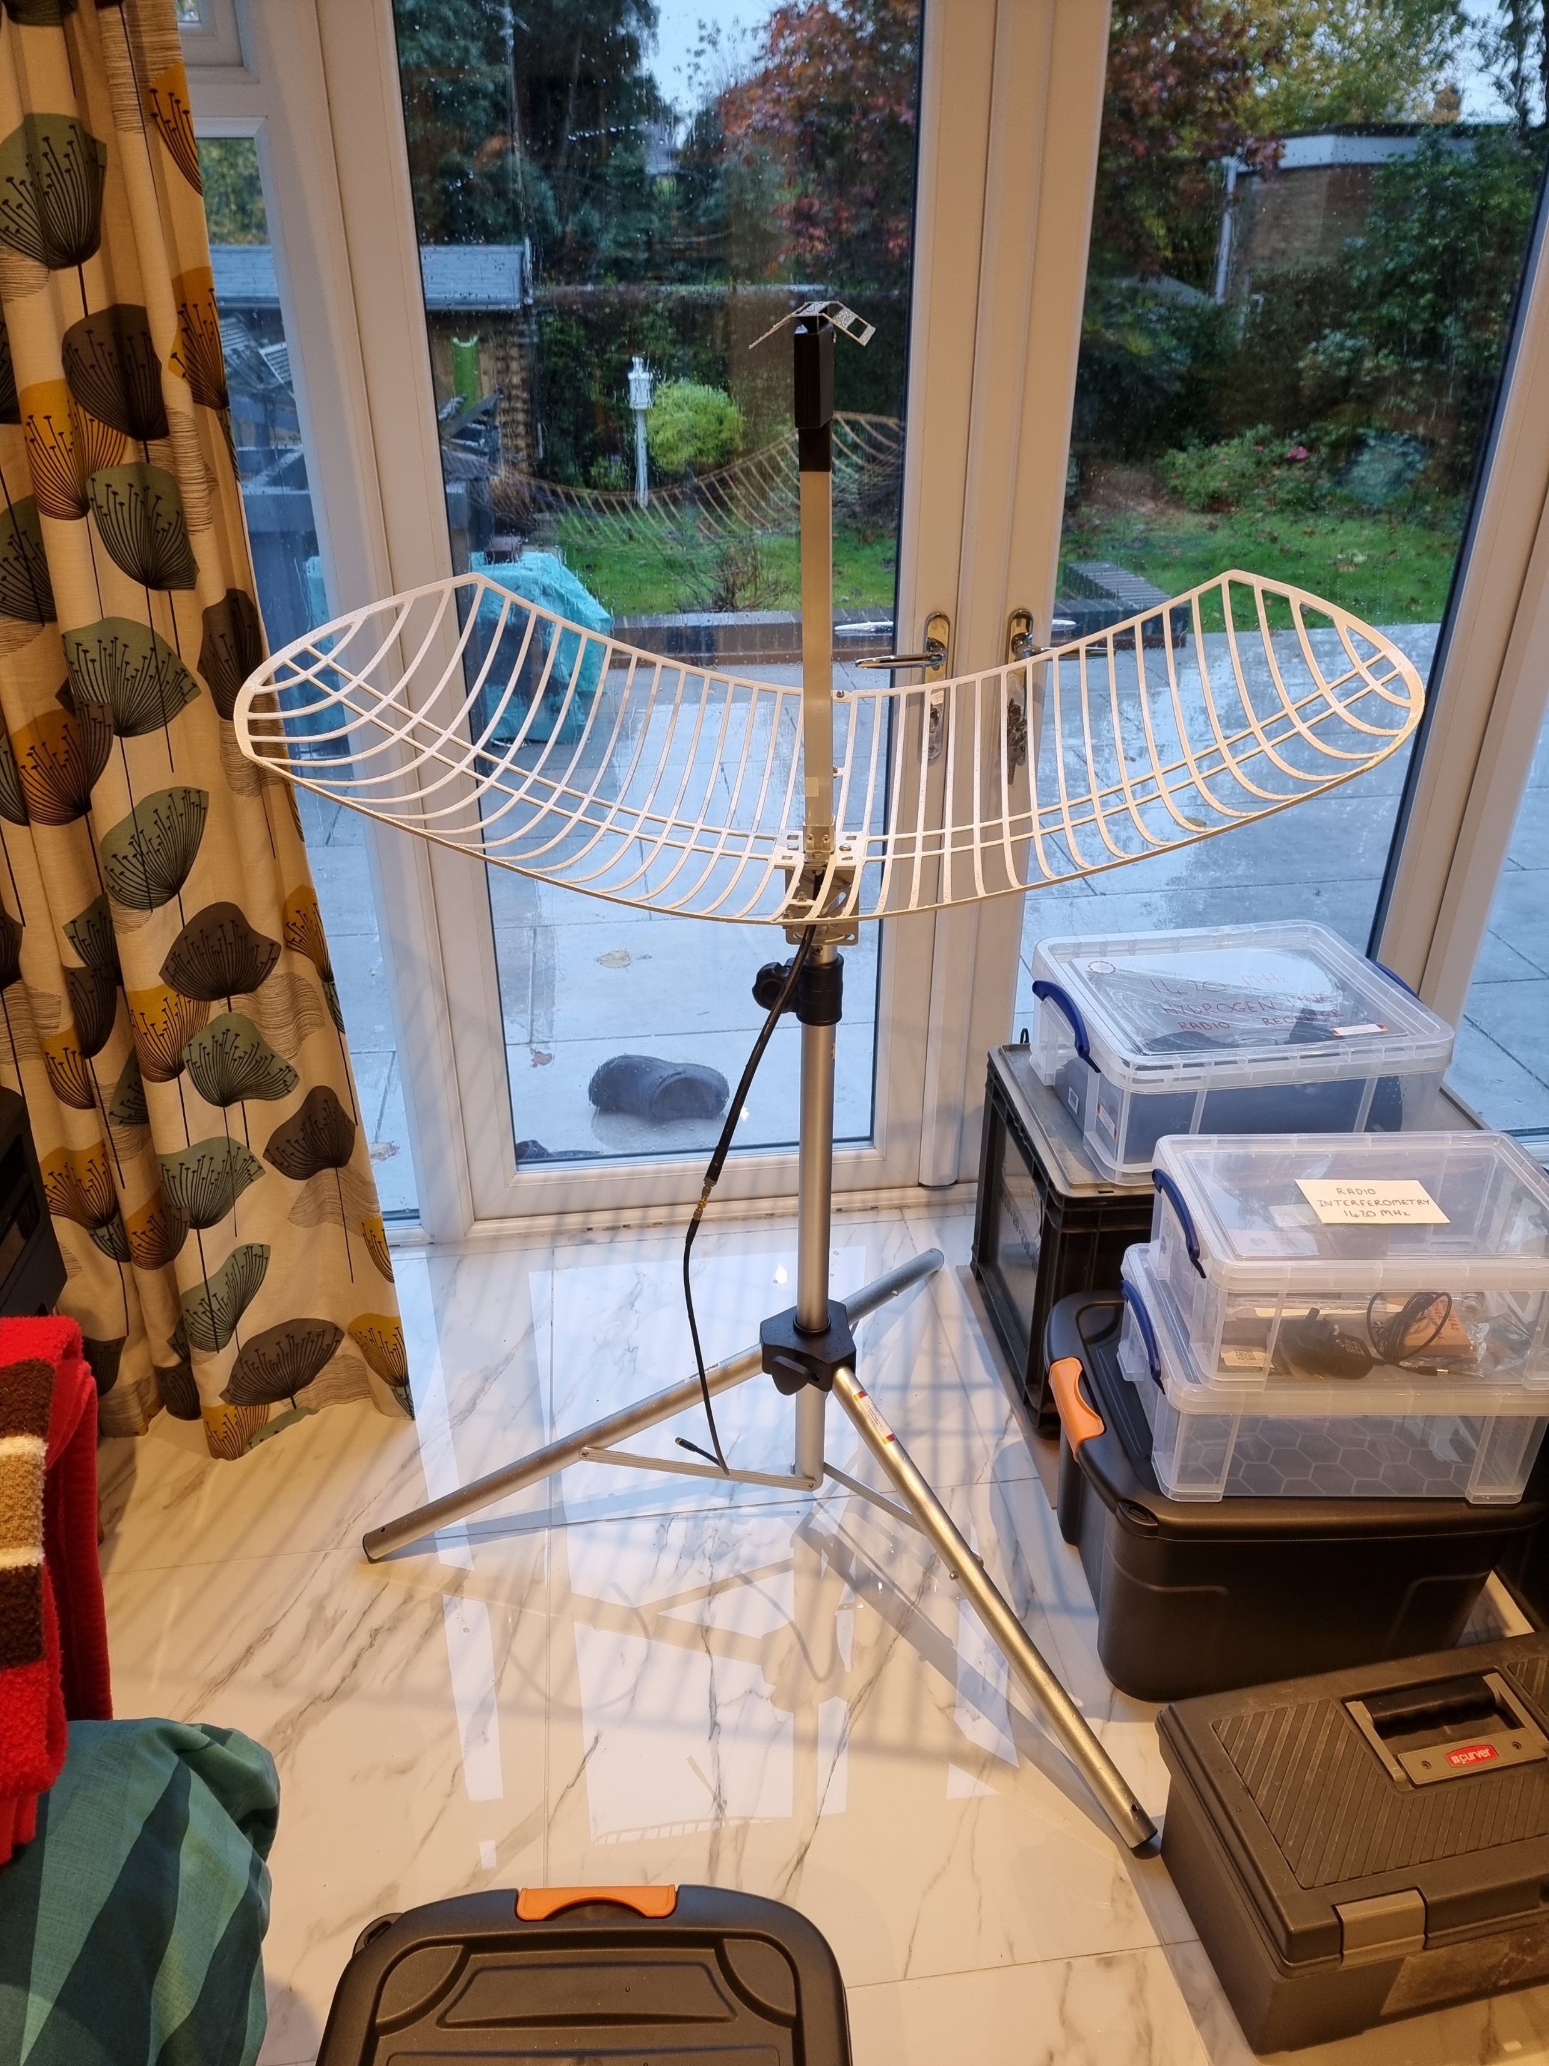
Testing the new Nooelec
1420MHz mesh aerial

Slide 33
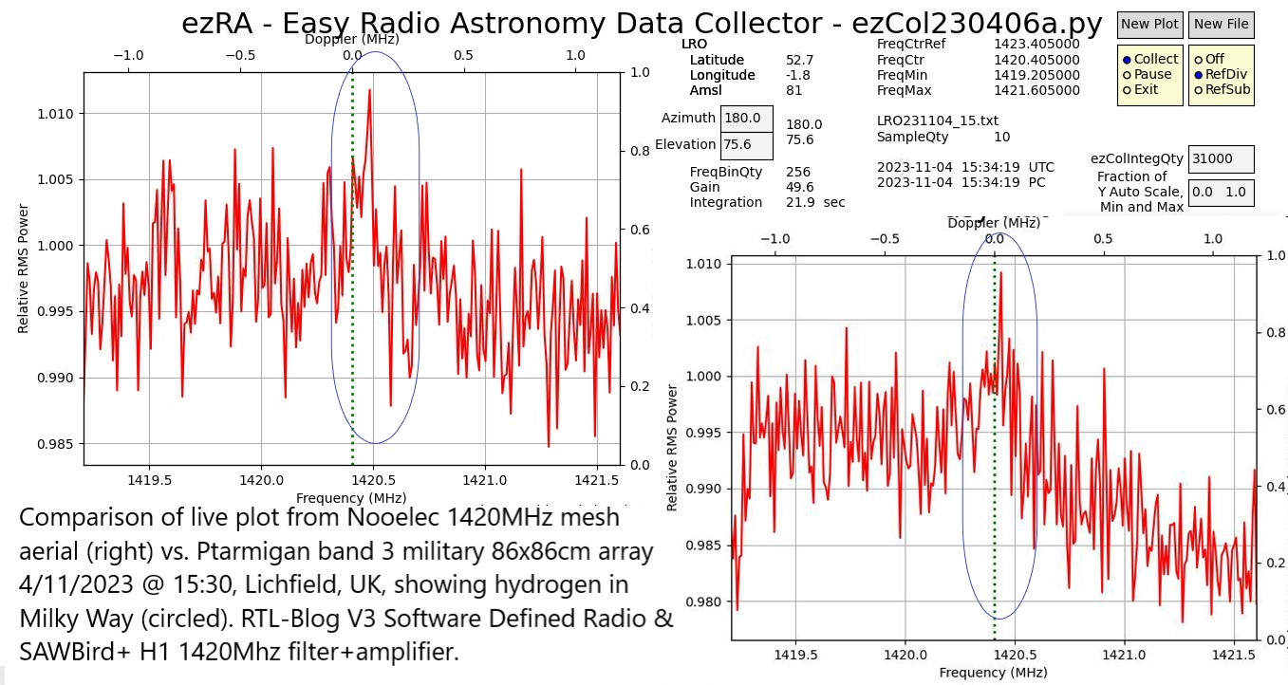

Slide 34
IMPORTANT ADVICE FOR NEWBEES WITH LITTLE KNOWLEDGE LIKE ME:
Get support and advice from BAA/SARA members.
Realize you need to dedicate lots of time to get it working.
Making mistakes and starting again is part of the fun.
Don’t feel embarrassed that you do not know enough.
If your kit works then do not get too worried when someone else says should be done differently – E.g. your aerial has too much ground noise/your dish isn’t deep enough or too deep.
Finally, do NOT estimate elevation and azimuth because your beamwidth seems large, MEASURE IT!

